Slide 1

Aushapur(V), Ghatkesar(M) , R.R Dist-50130
Department of Electronics and Communication Engineering
Major Project On
Remote Monitoring of Radiation and Environmental Conditions with
Telegram Responder Bot
Guided by:
Ms. P. Sreevani
Assistant Professor
Batch – AG 10
Akshay Rajpurohit (17P61A0405)
Poddutooru Rakesh (17C21A0419)
Bittu Nikhil (17P61A0425)
Pillarisetty Sai Charan (18P65A0419)

Slide 2
ABSTRACT
These days, the need to use radioactive sources has been increasing in every country and the same has been observed in India as well.
Research laboratories, personal radiation monitoring and field of radiation protection essentially need radiation detection instruments.
This project proposes to use low-cost hardware to build a monitor that measures Radiation levels and Environmental conditions (temperature and humidity) and relays the measurement readings to an endpoint on the internet, which would enable concerned parties to remotely keep a check on the system.

Slide 3
OBJECTIVE
To monitor and measure the radiation levels and environmental conditions (temperature and humidity) and graphically represent the readings.
To set up a Telegram Responder Bot for the authorities to interact with and to receive periodical updates about the radiation levels and environmental conditions and alert notifications if the readings cross predefined thresholds.
To relay all the information (measurements) to an endpoint on the internet for remote monitoring and analysis.

Slide 4
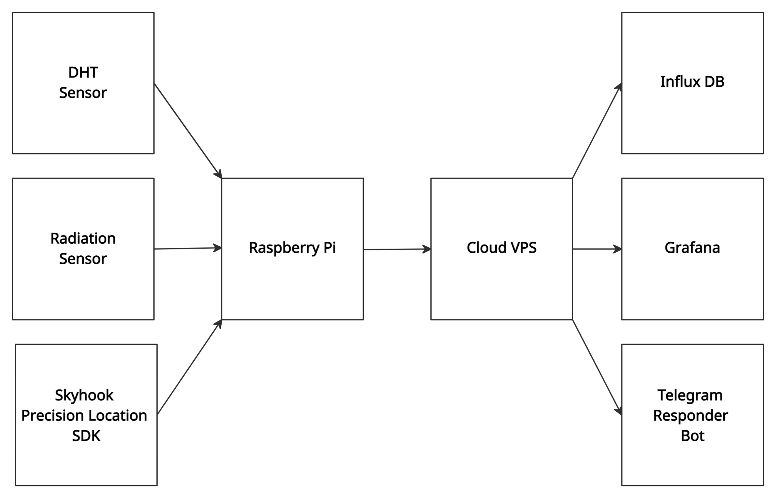
BLOCK DIAGRAM

Slide 5
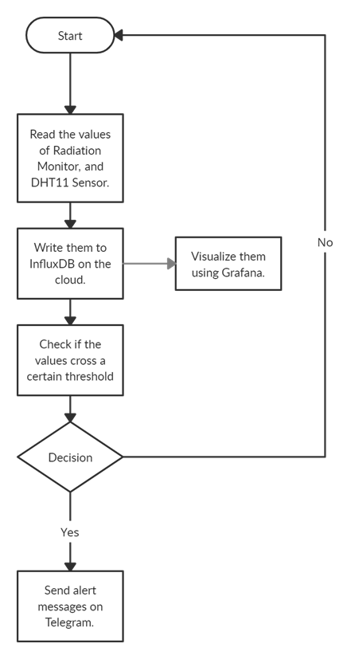
FLOW DIAGRAM

Slide 6
HARDWARE AND SOFTWARE REQUIREMENTS
Hardware Requirements: Raspberry Pi Geiger-Müller Tube High voltage DC-DC boost converter DHT Sensor microSD card - 4GB or higher | Software Requirements: Raspberry Pi OS on the Raspberry Pi Ubuntu 18.04 as our OS on the Cloud VPS InfluxDB as our Database Grafana for Analytics and Visualization
Notes:
‹#›

Slide 7
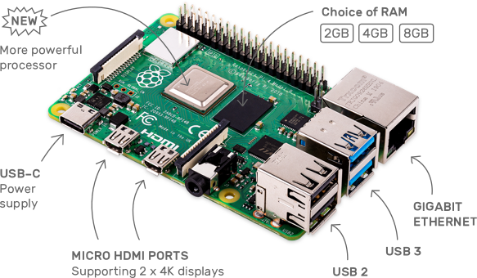
Raspberry Pi 4
Single Board Computer Internet Access via Wi-Fi or Ethernet Bluetooth Connectivity Powerful Processor USB and HDMI ports Affordable
Notes:
‹#›

Slide 8
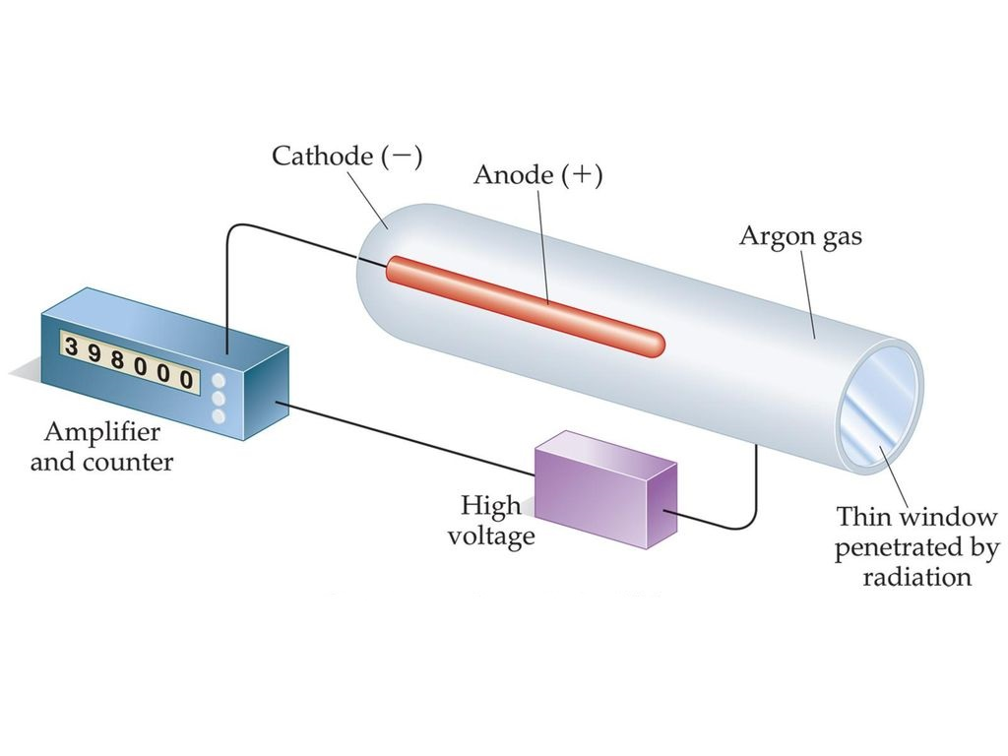
Geiger Müller Tube
Radiation Sensing Element Contains mixture of noble gas and halogen gas inside it (Ne / Ar + Halogen) Operates at 450V-650V DC Conducts current when Radiation falls on the tube (alpha, beta and gamma radiations)
Notes:
‹#›

Slide 9
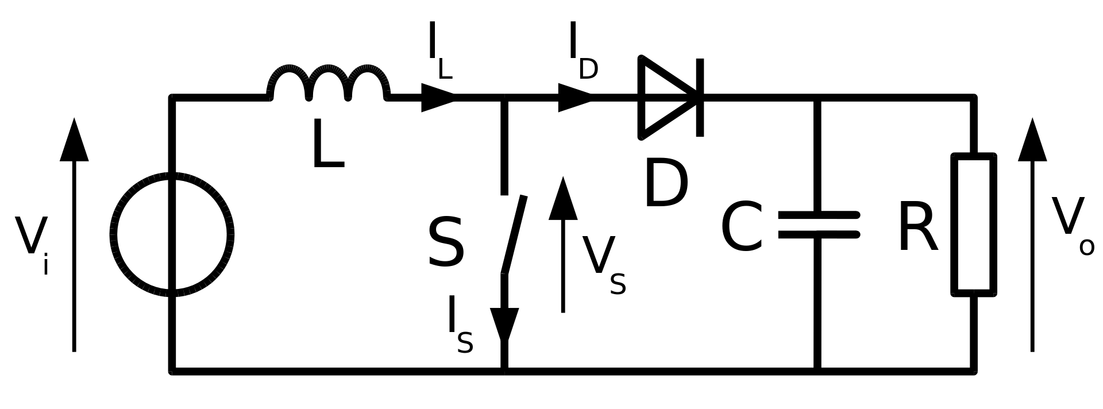
DC-DC Boost Converter
Steps up voltage from input to output. Contains two semiconductors (a diode and a transistor) and one storage element (a capacitor or an inductor). Used in Battery Powered Systems, Photovoltaic cells etc.
Notes:
‹#›

Slide 10
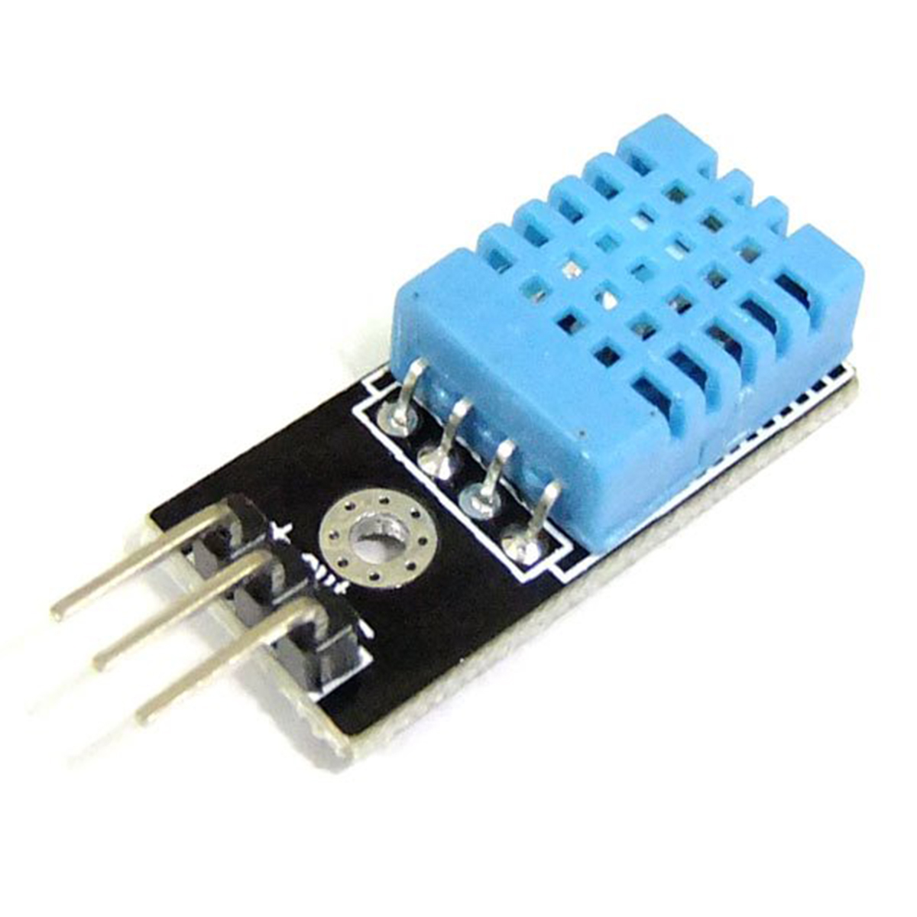
DHT11 Sensor
DHT sensors are made of two parts, a capacitive humidity sensor and a thermistor, and contains a basic ADC converter. Ultra low cost 3 to 5V power and I/O, 2.5mA max current use Humidity 20-80%, 5% accuracy Temperature 0-50°C, ±2°C accuracy 1 Hz sampling rate
Notes:
‹#›

Slide 11
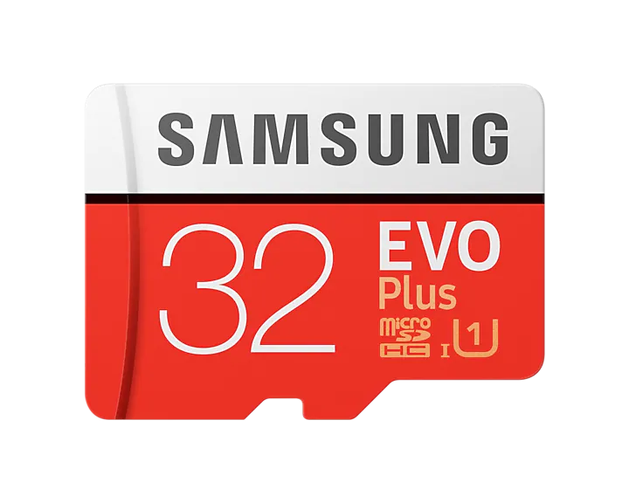
microSD card
Has a small physical size and is therefore portable. Non-volatile memory. High storage capacities (upto 1TB) High compatibility - compatible with almost every SBC, Digital Cameras, and smartphones. Cost effective Low power consumption
Notes:
‹#›

Slide 12

Raspberry Pi OS
Debian based operating system. Developed and Maintained by the Raspberry Pi Foundation. Highly optimized for all models of Raspberry Pi. Can be used to extensively control the Raspberry Pi (Serial Mode, I2C, etc.) APT is the package manager used to add/remove software.
Notes:
‹#›

Slide 13

Ubuntu Server
Debian based operating system. Developed and Maintained by the Canonical Ltd. Most used Operating System on servers APT is the package manager used to add/remove software. Receives regular security updates. Low usage of system resources.
Notes:
‹#›

Slide 14

InfluxDB
InfluxDB is a time series database designed to handle high write and query loads. Open source server agent to collect metrics from stacks, sensors and systems. Uses Flux for querying which is optimized for time series analysis. Provides client libraries in multiple programming languages.
Notes:
‹#›

Slide 15

Grafana
Grafana is an open source analytics & monitoring tool. Provides multiple visualizations such as Graphs, Heatmaps, Histograms, Geomaps etc. Allows transformation of data to summarize, combine and perform calculations across different queries and data sources. Has built-in alert mechanism.
Notes:
‹#›

Slide 16
PLAN OF ACTION
PRC | STATUS
PRC-1 | Based on our domain, we obtained a scientific paper and we prepared our abstract accordingly.
PRC-2 | Detection and measurement of radiation levels, climate conditions and geographical location, along with an Telegram Responder Bot system.
PRC-3 | Relaying of the information to the cloud, and graphical representation of the information on the local and remote computers.

Slide 17
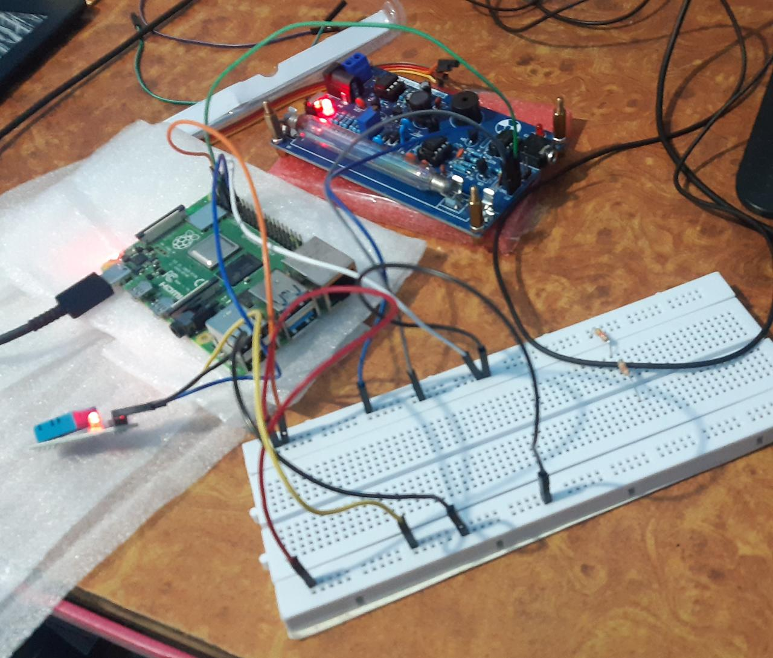
RESULTS

Slide 18
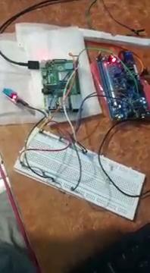
RESULTS

Slide 19
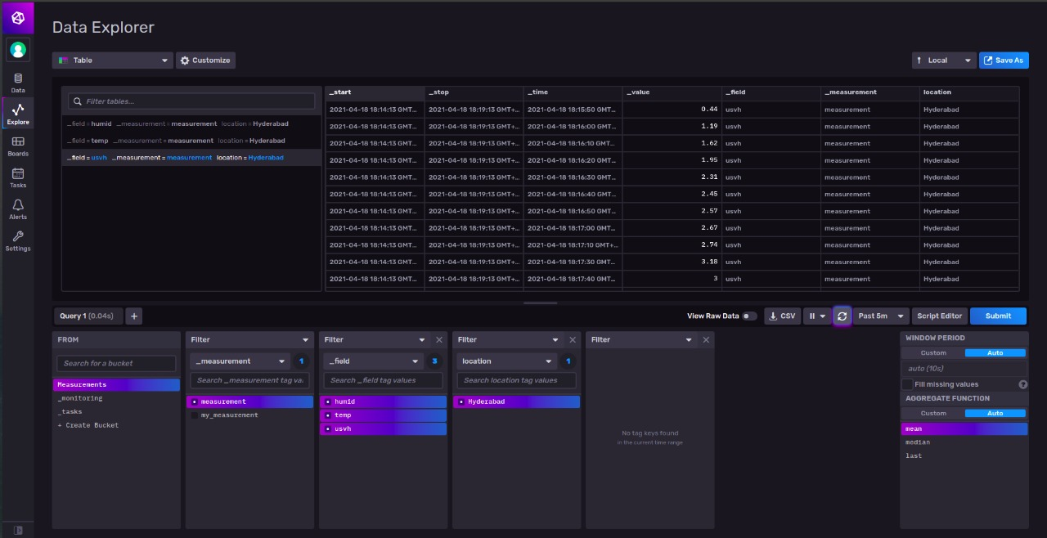
RESULTS

Slide 20
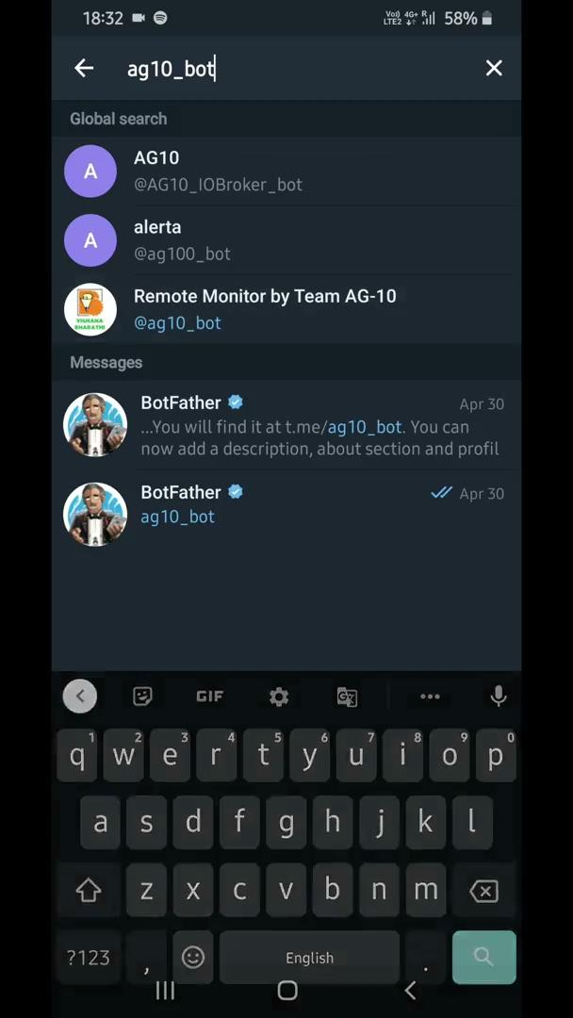
RESULTS

Slide 21
ADVANTAGES AND DISADVANTAGES
Advantages: A simple and a cost effective radiation and environmental conditions monitor. The Cloud platform allows authorities to remotely monitor areas of interest from anywhere in the world. Telegram Responder Bot alerts the authorities when the radiation/environmental condition levels cross the safety threshold levels and also sends periodical updates regarding the same. | Disadvantages: The Geiger-Müller tube is a delicate instrument, and should therefore be handled carefully. The power source for the apparatus (AA batteries) has to be replaced periodically. Has to be constantly connected to the internet for sending sensor readings to the cloud and therefore latency can be expected for the Telegram Responder bot.
Notes:
‹#›

Slide 22
APPLICATIONS
It can be used in areas surrounding Nuclear power plants. An example would be to install our device near water-bodies to check radiation contamination levels.
It can be used at mining sites to keep a check of radiation levels for the safety of the miners.
To detect radioactive rocks and minerals in the course of mineral prospecting or as a mineral collector.
Radiation detection in the scrap metal processing business, including oil field drill pipe that has been contaminated by Radium 226, an alpha emitter.
In or near X-ray labs in a medical facility, to check for leaks or possible exposure.
To check for irradiated gemstones in the jewelry trade.

Slide 23
REFERENCES
Holovatyy, Andriy; Teslyuk, Vasyl; Kryvinska, Natalia; Kazarian, Artem. 2020. "Development of Microcontroller-Based System for Background Radiation Monitoring" Sensors 20, no. 24: 7322. https://doi.org/10.3390/s20247322
Geiger Counter - Radiation Sensor Board for Arduino and Raspberry Pi Geiger Counter - Radiation Sensor Board for Arduino and Raspberry Pi
Creating a Telegram Bot using Python https://www.youtube.com/watch?v=PTAkiukJK7E
Notes:
‹#›

Slide 24
THANK YOU
Notes:
‹#›

